Slide 1
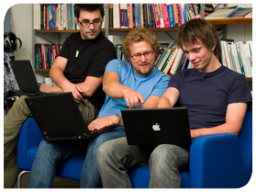
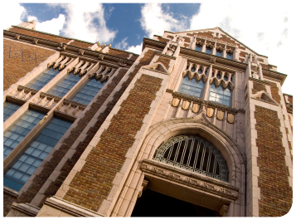


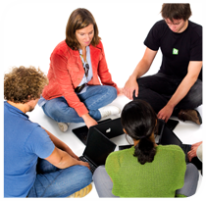

.
Qt u nastavi
Osnovne
ideje
vezane
za Qt
Notes:
This lecture will introduce Qt, it is divided into the following sections:
- overview and background
- the community
- installing the Qt tools
- a live demonstration of Qt Designer (see separate script)

Slide 2

Šta je Qt?
”Qt predstavlja okvir za multiplatformski razvoj aplikacija u C++.”
Originalna namena Qt-a je bila razvoj korisničkih interfejsa. Nakon toga je evoluirao i sada pruža podršku za:
  Baze podataka, XML, Web, multimediju, mrežno programiranje, OpenGL, skripting, ...
Notes:
Qt, is a cross platform development framework written in C++.
This does not limit the languages used. Bindings are available for Python, Ruby, C# (mono), Ada, Pascal, Perl, PHP (see: http://qt.nokia.com/products/programming-language-support)
Most people know Qt for its cross platform user interface abilities. Cross platform development is about so much more. For instance, just compare file paths between Windows and Unix. Qt provides classes for almost all conceivable tasks.

Slide 3
Šta je Qt?
Qt se sastoji od modula koji poštuju zajedničku šemu i zasnivaju se na istim idejama za API dizajn.
QtCore
QtGui
QtOpenGL
QtWebKit
QtNetwork
QtXml
Phonon
QtOpenVG
QtSql
QtScript
QtXmlPatterns
QtMultimedia
QtSvg
Notes:
Qt supports a multitude of functions in a cross platform manner. This means that Qt is a large package.
Qt is divided into modules, and when building and deploying, you can choose which module to use.
This helps reducing the number of bytes needed to deploy.
Also, there are a few platform specific modules (e.g. QtDBUS for inter process communication – unix only, QtAxContainer and QtAxServer for building and using ActiveX components – Windows only)

Slide 4

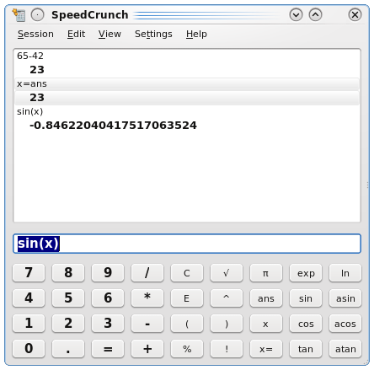
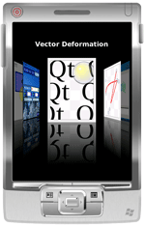
Namena Qt-a
Pravljenje aplikacija za različite platforme na osnovu istog izvornog koda.
Dobijaju se “native” aplikacije sa “native” izgledom.
Nudi API koji je jednostavan za korišćenje, obezbeđuje visoku produktivnost i otvorenost.
Notes:
The main purpose of Qt is its cross platform abilities, i.e. to create one source that can be compiled for all platforms.
The result should look, feel and simply be a native application.
Qt also strives at a intuit, easy to use and easy to re-use API. High developer productivity. Openess. Fun to use tools.

Slide 5

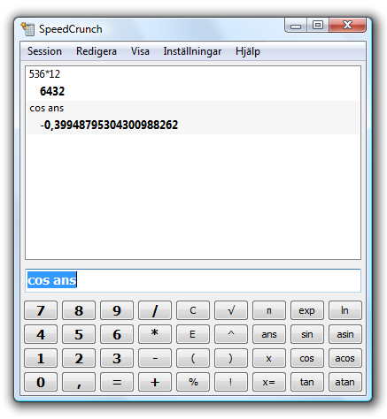
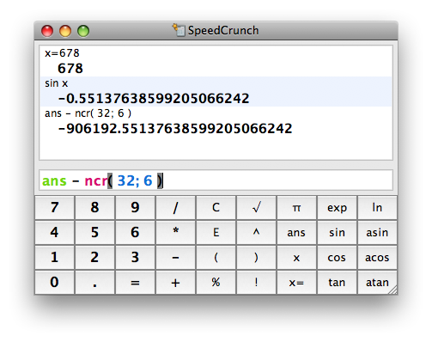
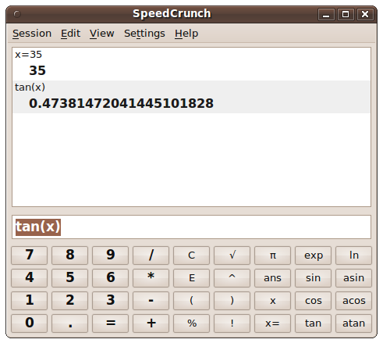
Podržane desktop platforme
Windows
Mac OS X
Linux/Unix X11
Notes:
Qt is available for all major desktop platforms.
Windows XP/Vista/7 are officially supported
OS X, latest version of Qt supports at least down to 10.3 (10.4 or later is required for development)
Linux/Unix with X11, i.e. not tied to Linux. Official support for Linux, AIX, HPUX, Solaris. Community support for FreeBSD, OpenBSD, NetBSD, etc.
Notice that the X11 support is not focused to deploying KDE on all desktops. Instead, Qt aims to integrate as a native part of all desktops, including Gnome.

Slide 6




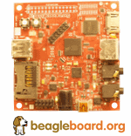
Podržane mobilne platforme
Android
iOS
Windows Phone
Embedded Linux
  Direktan pristup frame baferu
Notes:
Qt is also available for a number of embedded platforms.
Windows CE, versions 5 and 6.
Symbian S60, well tested with 3.1, 3.2 and 5.0.
Maemo, so you can use it on your N900 tablets
Embedded Linux, using the framebuffer directly, i.e. no X11 and a smaller footprint. Can accelerate on some platforms. A nice example is the beagleboard.
Tier 3 platforms: QNX, WxWorks. Supported by partner companies.

Slide 7



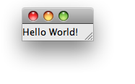
Prva Qt aplikacija
(Hello World)
Notes:
Walkthrough
The target of the project
This will be the starting point of the exercises for this lecture.

Slide 8
Hello World
#include <QApplication>
#include <QLabel>
int main( int argc, char **argv )
{
QApplication app( argc, argv );
QLabel l( "Hello World!" );
l.show();
return app.exec();
}
Notes:
Walkthrough
The entire source, focus on:
- simplicity
- small code

Slide 9
Hello World
#include <QApplication>
#include <QLabel>
int main( int argc, char **argv )
{
QApplication app( argc, argv );
QLabel l( "Hello World!" );
l.show();
return app.exec();
}
Notes:
Walkthrough
Focus on includes. All Qt classes are included by name, compare with iostream, etc. No “.h” ending, capitalization.

Slide 10
Hello World
#include <QApplication>
#include <QLabel>
int main( int argc, char **argv )
{
QApplication app( argc, argv );
QLabel l( "Hello World!" );
l.show();
return app.exec();
}
Notes:
Walkthrough
One QApplication object, drives the application, manages global settings.
There must always be a QApplication object.
You can always access the QApplication object through the qApp pointer. You can look at this as a singleton, but the instantiation must be made explicitly from the main function.

Slide 11
Hello World
#include <QApplication>
#include <QLabel>
int main( int argc, char **argv )
{
QApplication app( argc, argv );
QLabel l( "Hello World!" );
l.show();
return app.exec();
}
Notes:
Walkthrough
QLabel, is a widget. The text is passed to the constructor before the widget is shown.
Elaborate, everything is built from widgets. Widgets can be labels (as here), buttons, sliders, group boxes, windows, etc.
As the label does not have a parent widget, i.e. it is not contained by another widget, it is a top-level widget. This means that it will result in a new window that is decorated by the native window manager.

Slide 12
Hello World
#include <QApplication>
#include <QLabel>
int main( int argc, char **argv )
{
QApplication app( argc, argv );
QLabel l( "Hello World!" );
l.show();
return app.exec();
}
Notes:
Walkthrough
Calling exec start the event loop. This gets everything running.
The event loop ends when last window closes (can be turned off).
Having started the event loop, you must change mind-set. Everything from here on is event driven, be it user interaction (keys or mouse), network or timer.

Slide 13
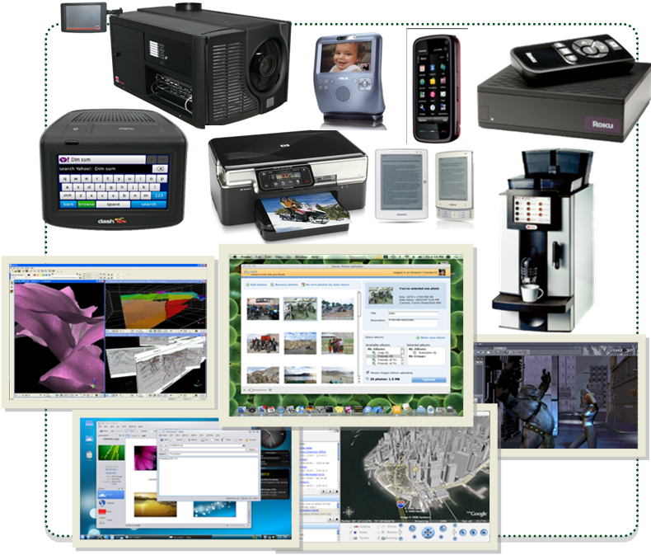
Gde se sve Qt koristi?
Notes:
Legend: Devices and Screenshots
(from top left)
• Dash Express by Dash Navigation, Inc.
• Digital cinema projector by Barco
• Asus Skype Phone
• Dash Navigation Device
• Samsun eReader
• HP Photosmart Web-enabled printer
• Nokia 5800 Xpress Music
• Roku set top box
• 3DMove by Midland Valley Exploration Ltd.
• Photo Uploader application by Hyves
• HGZ Kaffemaschinen
• HP Photosmart Printer
• KDE 4 desktop showing Dolphin and KMail
• Google maps application
• Daz3D by Daz Productions
Details on these and other Qt-based applications and devices is available at http://qt.nokia.com/qt-in-use/.

Slide 14

Ko sve koristi Qt?

Slide 15
Licence Qt-a
LGPL – besplatno
  Vaša aplikacija može biti otvorena ili zatvorena
  Sve promene u Qt kodu moraju biti prijavljene zajednici
GPL – besplatno
  Vaša aplikacija mora biti otvorena
  Sve promene u Qt kodu moraju biti prijavljene zajednici
Komercijalna licenca – plaća se
  Vaša aplikacija može biti zatvorena
  Promene u Qt mogu biti zatvorene
Notes:
As you could see in the former slide, Qt is present in both commercial, closed source, software, as well as in free, open source, software.
Historically, Qt has been dual licensed as Commercial and GPL, i.e. if you close your source, you will have to pay.
However, since Nokia's acquisition, the top priority is to attract users. Thus, the LGPL license was added.

Slide 16


Istorijat Qt-a
1991 – Haavard Nord i Eirik Chambe-Eng su započeli razvoj onoga što će postati Qt za X11 i Windows platforme
1994 – Oformljena je kompanija Trolltech
1996 – Započet je KDE projekat od strane Matthias Ettrich-a
Notes:
Qt development started in 1991 byt Haavard Nord and Eirik Chambe-Eng.
Original version supported X11 and Windows.
In 1994, the company was formed. Originally named Quasar Technologies, then Troll Tech and finally Trolltech.
In 1996, Matthias Ettrich started the KDE project. Matthias now works as lead software engineer for Qt.

Slide 17

Istorijat Qt-a
2001 – Dodata podrška za Mac OS X
2005 – Obezbeđena GPL licenca za sve platforme
2008 – Nokia preuzima Trolltech
2009 – Dodata podrška za S60 (Symbian)
2012 – Digia preuzima Qt, izlazi Qt5
Notes:
In 2001, OS X, is added as supported desktop environment. Anecdote: there was actually an experimental support for OS 9 in the Qt 3 days.
During the years, different platforms were released as GPL, and in 2005 all platforms had that license.
Anecdote: Originally, Qt was freely available under the QPL (Qt Public License) which caused some to be upset and the launch of the Gnome project. As a response to this X11 was released under GPL in 2000. OS X was released under GPL in 2003 (XonX made it possible to use X11 on OS X at the time). Finally, in 2005, Windows was released as GPL.
In 2008, Nokia bought Trolltech.
2009, with the release of Qt 4.6, Symbian and S60 became a supported platform of Qt.

Slide 18
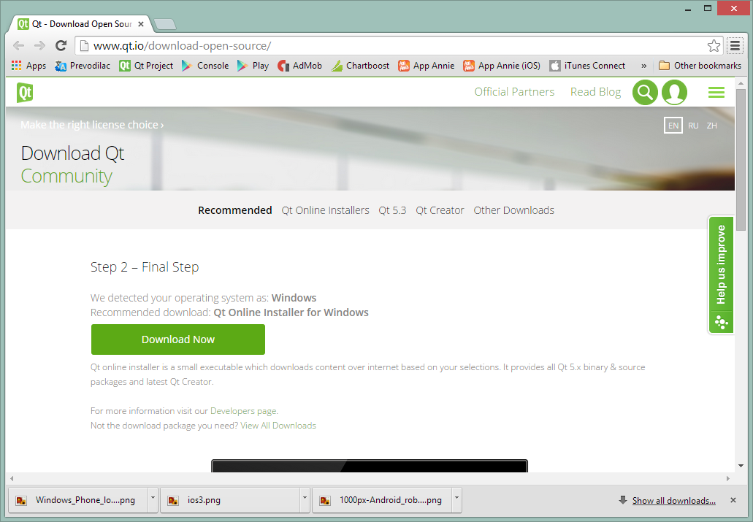
Preuzimanje Qt-a
Instalacije se mogu preuzeti sa
http://www.qt.io/download-open-source/
Notes:
You can get Qt from two locations. Either you visit the Qt site and simply download a snapshot.
This can be either an official release, a tech preview or beta software. Qt is released both early and often.
If you want to have access to the bleeding edge of Qt, you can visit Qt at gitorious. Here you can take part in the ongoing work on the next version of Qt, as well as different research branches and such.

Slide 19

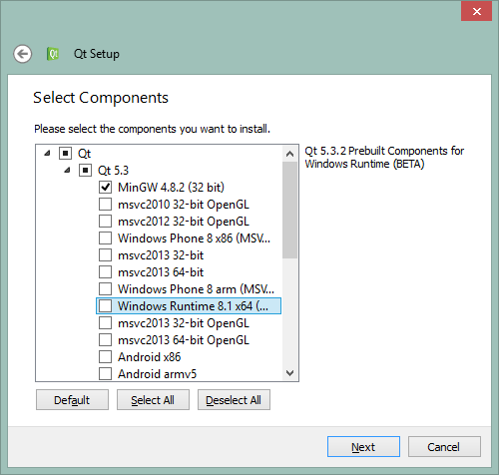
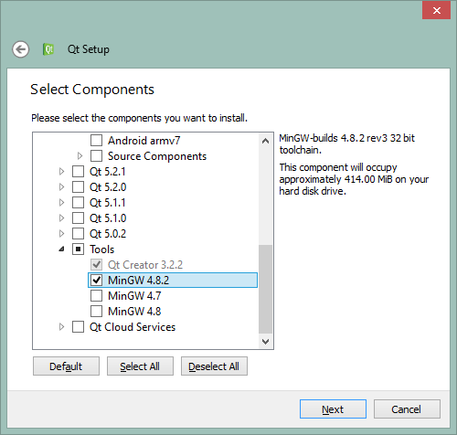
Preuzimanje Qt-a
Online installer
Notes:
The easiest way to get started is to download the Qt SDK. It contains all the things needed to get started developing with Qt.

